Slide 1
As good as your word
#CopyCon2018
Celia Anderson
Partner at Siblinc
siblinc.com

Slide 2
A few words
about us
Two sisters on a mission
World leaders
Beside the seaside
Flawless product copy
All shapes and sizes

Slide 3
Some of the brands we’ve written for

Slide 4
A few words
about us
Flawless product copy

Slide 5
TOV dexterity, the Siblinc way

Slide 6
TOV dexterity, the Siblinc way

Slide 7
TOV dexterity, the Siblinc way

Slide 8
Looking good, wherever you are
Consistency

Slide 9
Looking good, wherever you are
Direct
mail
Consistency

Slide 10
Looking good, wherever you are
Direct
mail
Social
Consistency

Slide 11
Looking good, wherever you are
Direct
mail
Social
Consistency
Blogs

Slide 12
Looking good, wherever you are
Direct
mail
Social
Consistency
Blogs
Radio/TV

Slide 13
Looking good, wherever you are
Direct
mail
Social
Consistency
Out of home
Blogs
Radio/TV

Slide 14
Looking good, wherever you are
Direct
mail
Billboards
Social
Consistency
Out of home
Blogs
Radio/TV

Slide 15
The TOV toolkit
Thorough guide
Quick reference guide for TOV inspiration
Rule checker
Not just for writers: finance, sales and admin
Brand personality applied across all communications

Slide 16
Keywords
Verbs
Adverbs
Keywords
Nouns
Adjectives

Slide 17
Yes-yes
‘Elevated’

Slide 18
Yes-yes
‘Elevated’
‘Precision’

Slide 19
Yes-yes
‘Elevated’
‘Precision’
‘Style’

Slide 20
Yes-yes
‘Elevated’
‘Precision’
‘Style’
‘Crisply tailored’

Slide 21
Yes-yes
‘Elevated’
‘Precision’
‘Style’
‘Crisply tailored’
‘Engineered’

Slide 22
Yes-yes
‘Elevated’
‘Precision’
‘Style’
‘Crisply tailored’
‘Engineered’
‘A perfect fit’

Slide 23
Yes-yes
‘Elevated’
‘Precision’
‘Style’
‘Crisply tailored’
‘Engineered’
‘A perfect fit’
‘Advanced’

Slide 24
Yes-yes
‘Elevated’
‘Precision’
‘Style’
‘Crisply tailored’
‘Engineered’
‘A perfect fit’
‘Advanced’
‘Contemporary’

Slide 25
No-no
‘Value for money’

Slide 26
No-no
‘Value for money’
‘Trendy’

Slide 27
No-no
‘Value for money’
‘Trendy’
‘Premium’

Slide 28
No-no
‘Value for money’
‘Trendy’
‘Premium’
‘Magnificently’

Slide 29
No-no
‘Value for money’
‘Trendy’
‘Premium’
‘Magnificently’
‘Function’

Slide 30
No-no
‘Value for money’
‘Trendy’
‘Premium’
‘Magnificently’
‘Function’
‘Excellent’

Slide 31
No-no
‘Value for money’
‘Trendy’
‘Premium’
‘Magnificently’
‘Function’
‘Excellent’
‘Decorative’

Slide 32
No-no
‘Value for money’
‘Trendy’
‘Premium’
‘Magnificently’
‘Function’
‘Excellent’
‘Decorative’
‘Superb’

Slide 33
Different strokes…
‘Progressive’
✔️
‘Directional’
✔️
‘Refined’
✖️

Slide 34
…for different folks
‘Progressive’
‘Progressive’
✔️
✖️
‘Directional’
‘Directional’
✔️
✖️
‘Refined’
‘Refined’
✖️
✔️

Slide 35
Customer avatars
Name

Slide 36
Customer avatars
Name
Age

Slide 37
Customer avatars
Name
Age
Job title

Slide 38
Customer avatars
Name
Age
Job title
Children

Slide 39
Customer avatars
Name
Age
Job title
Professional goals
Children

Slide 40
Customer avatars
Name
Age
Personal goals
Job title
Professional goals
Children

Slide 41
Customer avatars
Name
Family goals
Age
Personal goals
Job title
Professional goals
Children

Slide 42
Customer avatars
What is motivating them to buy something?
Why is your option the best?
How would your option make them feel?
What changes would it make to their daily life? Confidence? etc.
What other options can you offer them that your competitors can't?

Slide 43
Painting a thousand words
Vision
board

Slide 44
Painting a thousand words
Images
Vision
board

Slide 45
Painting a thousand words
Images
Vision
board
Words

Slide 46
Painting a thousand words
Images
Vision
board
Patterns
Words

Slide 47
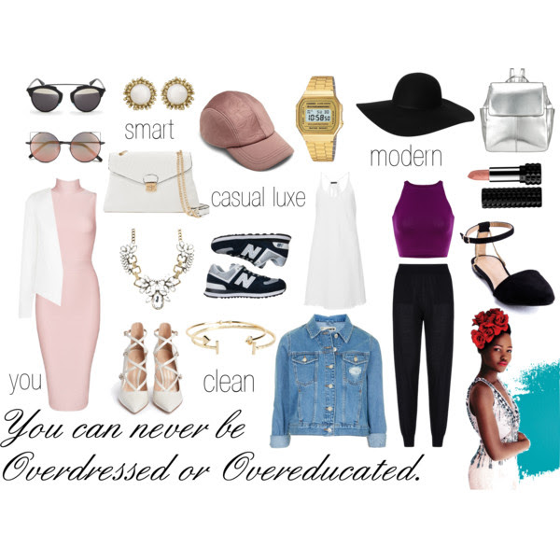
Painting a thousand words

Slide 48
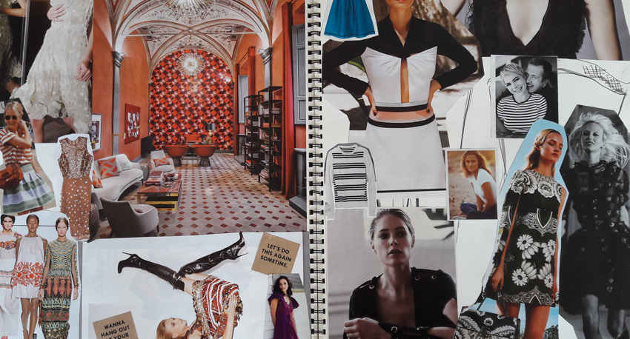
Painting a thousand words

Slide 49
Words of warning
How it can go wrong
Different rules apply to different mediums
Social media: balance of legality and creativity
Don’t overegg the TOV

Slide 50
Words of encouragement
Great examples
Before/after
Customer feedback on TOV
How far we've come

Slide 51
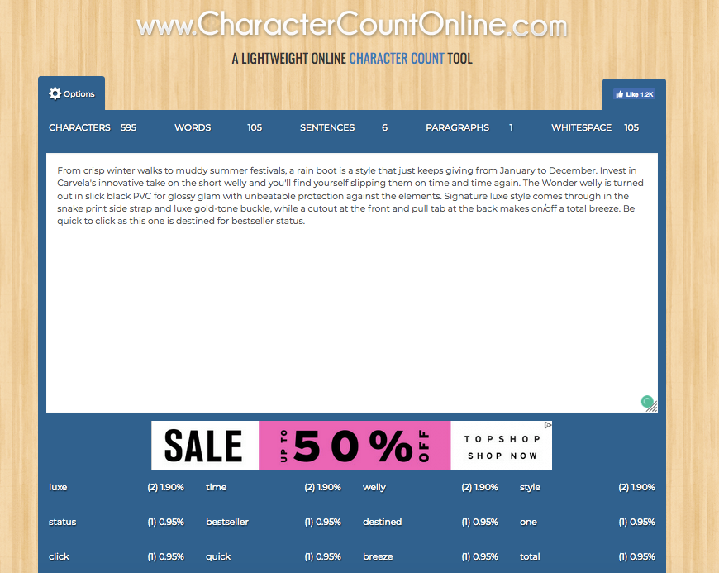
Belt and braces

Slide 52
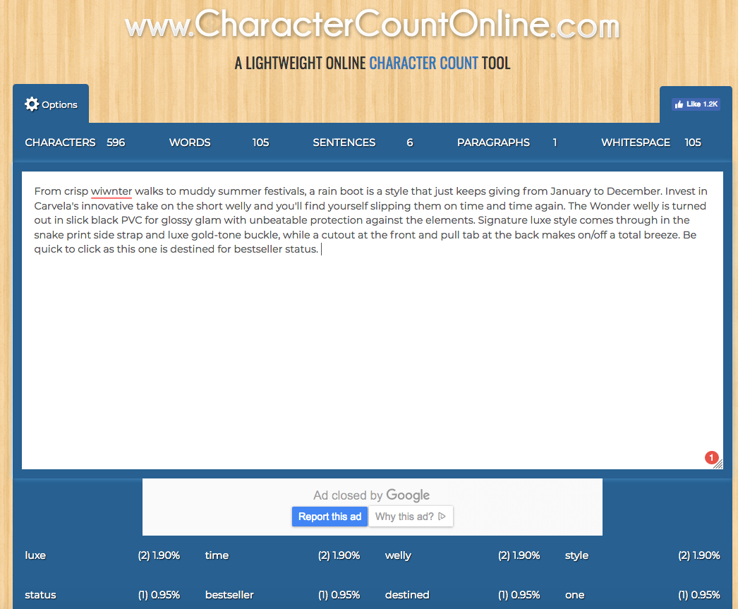
Belt and braces

Slide 53
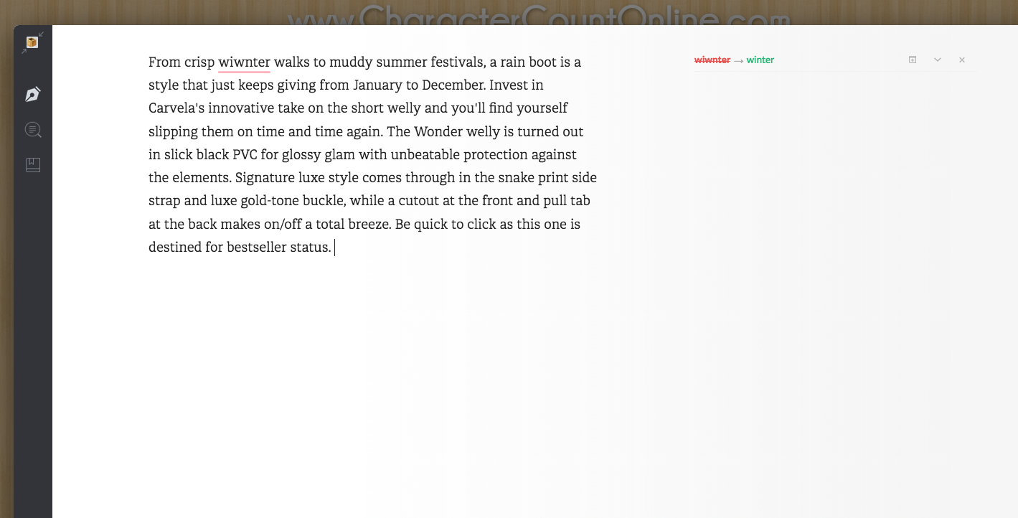
Belt and braces

Slide 54
Putting it all into place
Build your own TOV toolkit
Six-step plan
In depth as possible

Slide 55
Building a robust TOV toolkit
Keywords
Avatars
Vision board(s)
What to avoid
What to aim for
Avoid repetition
Check, check and check again

Slide 56
Thank you
Thanks for your time!
Get in touch:
celia@siblinc.com
www.siblinc.com

